Slide 1

Dude, Where’s My Paycheck?
Ricardo Dominguez
Kevin Athey
Benjamin Raehpour
Grecia Acosta

Slide 2
Paycheck Protection Program (PPP)
The PPP was enacted under the CARES Act
Purpose: keep workers employed during the lockdowns and reduce the economic impact of COVID-19 to small businesses.
Part of the deal before being passed was the promise of complete transparency.
Issues and Scandals:
Large public corporations applying for funds meant mostly for small businesses
US Treasury refusing to provide the complete transparency they initially promised
Many people starting doubting the efficacy of the program
After public backlash, and a Freedom of Information Act (FOIA injunction, the Treasury released some of the numbers to the public.
Our goal is to look through this data and find out whether the program succeeded at its initial goal of keeping the most workers employed and propping up small businesses to weather the COVID-19 lockdowns.
Notes:
Before we begin, I will mention that our data was difficult to work with. The treasury would not provide exact loan amounts for loans 150k and over, instead opting to provide ranges which we will show in our visualizations. We also used the census api to map some demographic data based on zip codes.

Slide 3

We started off with some basic visualizations to provide us with a preliminary analysis of the data. Below are the questions we seek to answer in our analysis:
How much of the loans went to “small businesses” in Kansas and Missouri?
Impact distribution: tracking PPP loan data against demographic factors (poverty rate, race, etc).
How did the PPP loans impact KS and MO separately?

Slide 4
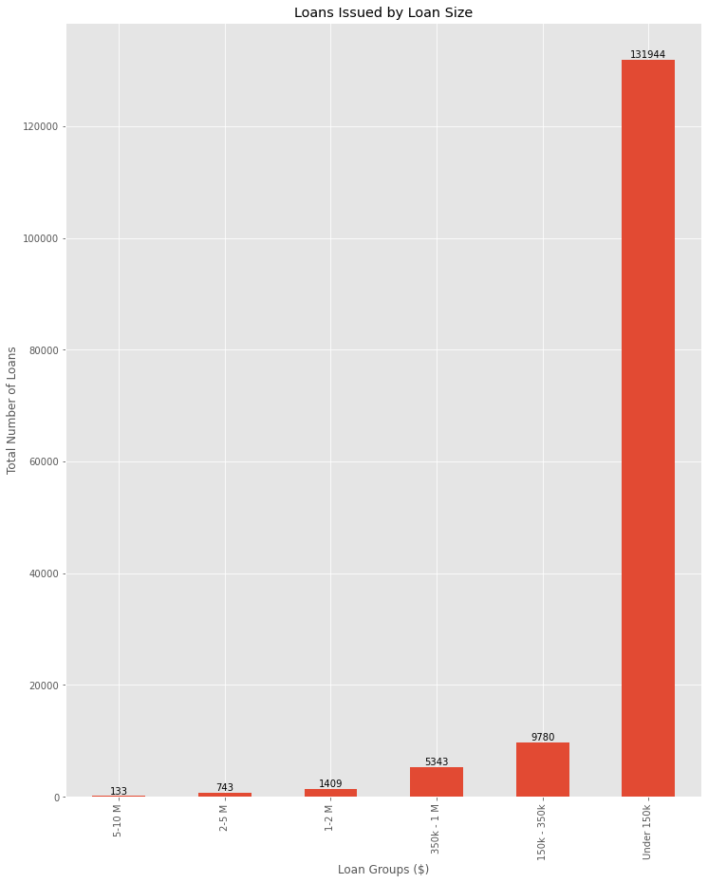
Loans Issued by Loan Size
Loans issued for the "150k and below" bucket had the most number of loans by a significant margin.
This graph illustrate that loans under $150K represent 88 percent of total PPP loans. Loans over $5m are less than 1 percent of total PPP loans.
Data shows that PPP loans were heavily distributed to smaller loans.

Slide 5
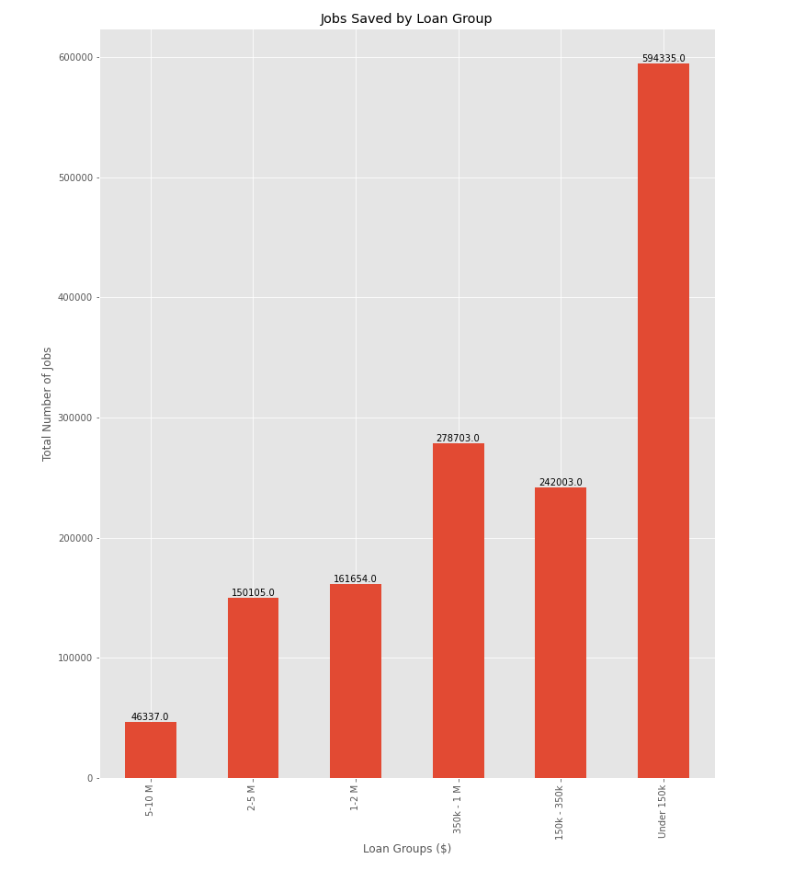
Jobs saved by Loan Group
The graph data indicates that around 1,473,137 million jobs were retained due to the program.
The number of jobs saved at the "150k and below" bucket also had the most number of jobs saved
Because of the concentration on smaller loans, this could be possibly reflecting an effort to target job retention for smaller businesses.

Slide 6
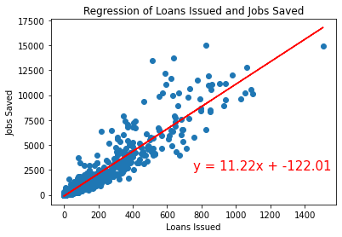
Regression of Loans Issued & Jobs Saved
Scatter plot reveals there is a positive correlation between loans issued and jobs saved. Data grouped by zip code.
Reservations:
The number of loans issued is simply an aggregate that does not take into consideration loan amounts
Jobs saved is a self-reported number by the businesses who applied for the loans, leading to possible skew in actual unemployment numbers.
Notes:
Despite this, it is in a ‘business' best interest to keep employees after receiving the loan due to the stipulation that converts the loan into a grant if employees are retained.

Slide 7
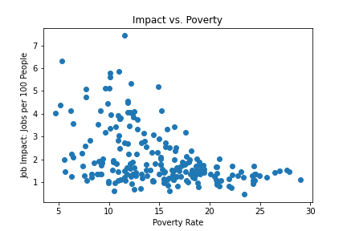
Impact vs Poverty
We thought it might be worth exploring the relationship between the poverty rate and the number of jobs added to find out if the PPP loans were distributed to the communities that needed it the most. Our analysis is as follows:
Compare the poverty rate (a percentage) against the number of jobs added per 100 people in the county
Run regression to test correlation
Split the data by state and rerun regression analysis to find changes
*** This shows the combine Kansas and Missouri Impact vs Poverty***

Slide 8
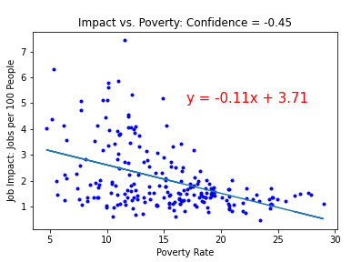
Impact vs Poverty
Rerun the above scatter but with a trend line.
The confidence interval is not overwhelming, but the trend is notable.
The poorer the county, the less help was received from PPP loans
*** This shows the combine Kansas and Missouri Impact vs Poverty***

Slide 9
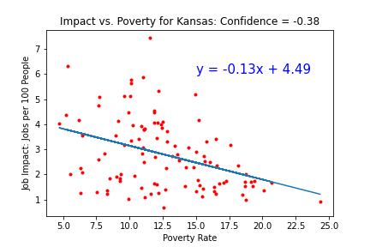
Impact vs Poverty for Kansas
KS had more loans per capita than MO, but the loans were not as evenly distributed with more loans going to wealthier counties.

Slide 10
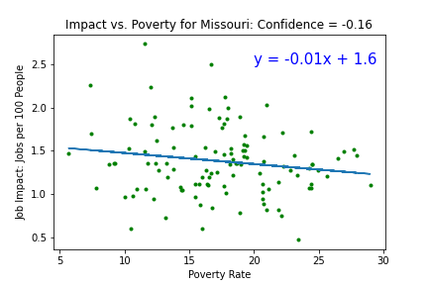
Impact vs Poverty for Missouri
MO had fewer loans per capita than KS, with loans distributed relatively evenly per county based on income levels.

Slide 11
Summary
Did the PPP succeed? It depends!
Nays:
The data is self-reported from borrowers, not all data fields were required and not all borrowers provided all information. This means important information for evaluation like demographic information of business owners was not fully captured.
Data provided by the Treasury did not reflect exact loan amounts, limiting our options for data exploration
Yays:
Based on data, seems that the majority on the funds were distributed to smaller loans which tends to believe that there was a focus for smaller businesses.
We can assume that over a million jobs were retained with the PPP loans in KS and MO.
Both KS and MO had roughly the same amount of loans issued (105k vs 115k respectively).

Slide 12
References
GovTrades. (2020, July 06). SBA Paycheck Protection Program (PPP) Loan Data. Retrieved September 08, 2020, from https://www.kaggle.com/govtrades/sba-paycheck-protection-program-loan-data?select=foia_150k_plus.csv
Open Government Data Sources: The U.S. Small Business Administration. (2020). Retrieved September 08 2020, from https://www.sba.gov/about-sba/sba-performance/open-government/digital-sba/open-data/open-data-sources
Pub/time.series/la/MO. (2020). Retrieved September 09, 2020, from https://download.bls.gov/pub/time.series/la/
Pub/time.series/la/KS. (2020). Retrieved September 09, 2020, from https://download.bls.gov/pub/time.series/la/

